Slide 1
Structure Learning of Bayesian Networks using Genetic Algorithms (Final Presentation)
Presenters:
Biniam Gebru
Mrinmoy Sarkar
Advisor: Dr. Abdollah Homaifar
Spring, 2018

Slide 2
Outline
Part I – Background
What was the Problem?
What are Bayesian Networks?
What is Structure Learning?
Summary of Various Approaches
Structure Learning using GA
Implementation/Simulation details
Part II: Results & Discussion
Simulation Results
Discussion & Conclusions

Slide 3
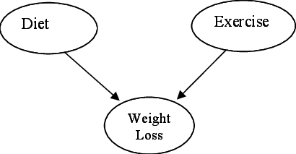
Part I - Background
Problem Statement
Searching the Bayesian Network (BN) that best reflects the dependence relations in a database of cases.
The problem of searching the BN that best reflects the dependence relations in a database of cases is a difficult one because of the large number of possible DAG structures, given even a small number of nodes to connect.
BNs are directed acyclic graphs (DAGs), where the nodes are random variables and where the arcs specify the independence assumptions between these variables.
After construction, a BN constitutes an efficient device for performing probabilistic inference.
Given:
A set of data example, sampled from a Bayesian Network
E.g.: Diet=Low, Exercise=No, Weight Loss = Low; Diet=High, Exercise=Yes, Weight Loss = High;
Unknown:
The Bayesian Network from which the data is sampled

Slide 4
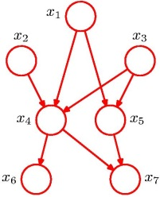
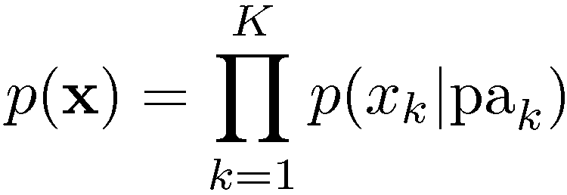

Part I ...
Bayesian Networks
Provide us with efficient representation and inference
Exploiting dependency structure makes it easier to represent and compute with probabilities
Represent causal dependencies among variables - causal graphical models
Express underlying causal structure
Causality simplifies inference
Using a representation in which the direction of causality is correct produces sparser graphs
Learning causal graphical models
Strength: how strong is a relationship?
Structure: does a relationship exist?
Structure Learning
The number of possible network structure for n node of a Bayesian network can be found by using the following formula:
$$f\left(n\right)=\sum_{i=1}^{n}{{\left(−1\right)}^{i+1}\frac{n!}{\left(n−i\right)!n!}2^{i\left(n−i\right)}f(n−1)}$$

Slide 5
Part I ...
Various methods
Evolutionary algorithms(e.g.: GA)
Neural network
Simulated annealing
Tabu search
Target analysis
Structure Learning Using GA
Representation of candidate solution
Crossover operation
Mutation operation

Slide 6
Part I ...
Crossover operation
Suppose we have two candidate solution given below:
P1 = 000000110
P2 = 001001000
If we choose crossover point at k=6 then,
C2 = 001001110
C1 = 000000000
But C1 is not valid structure
Remark: So, crossover is not a closed operator for this problem.
X1
X2
X3
X3
X1
X2
P1
P2
X1
X2
X3
X3
X1
X2
C2
C1

Slide 7
Part I ...
Mutation operation
Suppose we have one candidate solution as given below:
P1 = 010001000
Now if we flip the red bit then the resultant child is:
C1 = 010001100
Which is not a valid structure.
Remark: So, mutation is not a closed operator too for this problem.
X1
X2
X3
P1
X1
X2
X3
C1

Slide 8
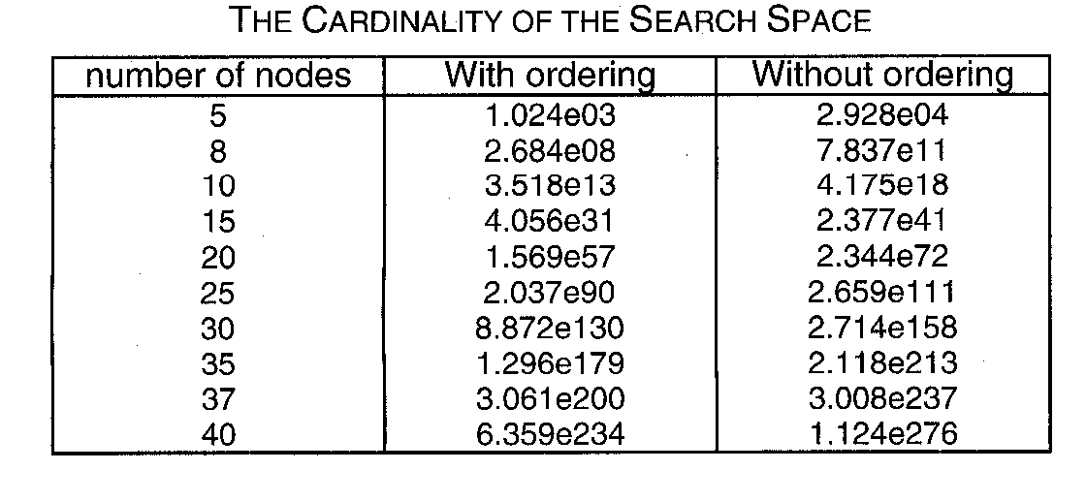
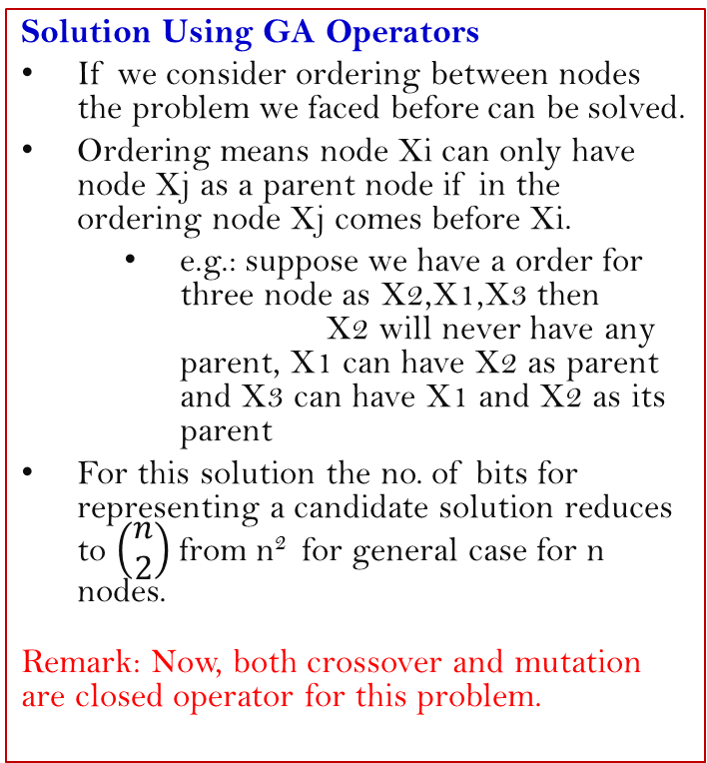
Part I ...
Solution Using GA Operators
If we consider ordering between nodes the problem we faced before can be solved.
Ordering means node Xi can only have node Xj as a parent node if in the ordering node Xj comes before Xi.
e.g.: suppose we have a order for three node as X2,X1,X3 then X2 will never have any parent, X1 can have X2 as parent and X3 can have X1 and X2 as its parent
For this solution the no. of bits for representing a candidate solution reduces to $\left(\begin{matrix}n \\ 2\end{matrix}\right)$from n² for general case for n nodes.
Remark: Now, both crossover and mutation are closed operator for this problem.
Consequence of Ordering
Remark: The problem is still NP hard

Slide 9
Part II - Results
Simulation Model
Simulation Results
Discussion & Conclusion

Slide 10
Part II - Results
Implementation/Simulation details
Determinate a BN (Structure + conditional probabilities) and simulate it, obtain a database of cases D, which must reflect the conditional independence relations between the variables.
Using GA find BN structure B* , which maximizes the probability P(D|B)
Evaluate the fitness of the solutions found

Slide 11
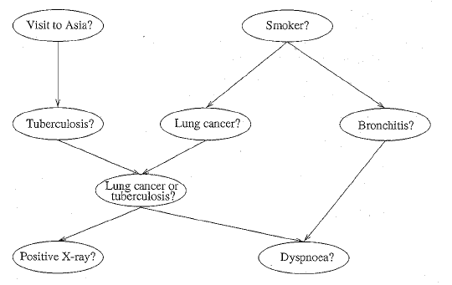
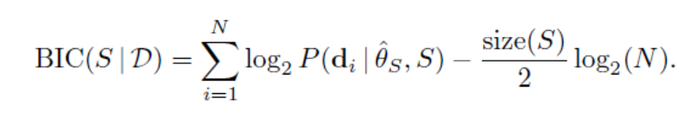
Part II
ASIA Network Structure
Simulation Model
Remark: The problem is still NP hard

Slide 12
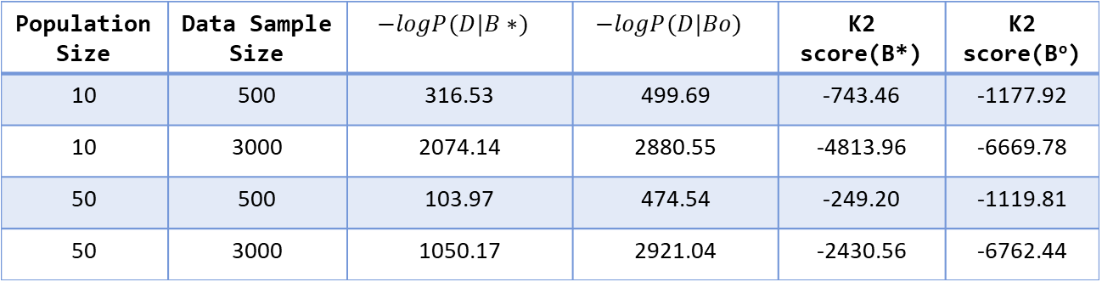
Part II - Simulation Result(Cancer Network)
Population Size | Data Sample Size | $$−logP(D|B∗)$$ | $$−logP(D|Bo)$$ | K2 score(B*) | K2 score(Bº)
10 | 500 | 316.53 | 499.69 | -743.46 | -1177.92
10 | 3000 | 2074.14 | 2880.55 | -4813.96 | -6669.78
50 | 500 | 103.97 | 474.54 | -249.20 | -1119.81
50 | 3000 | 1050.17 | 2921.04 | -2430.56 | -6762.44
No. of generation = 100, pc = 0.5, pm=0.01,

Slide 13
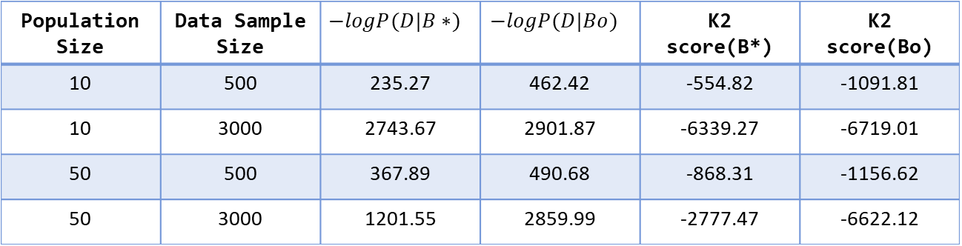
Part II - Simulation Result(Cancer Network)
Population Size | Data Sample Size | $$−logP(D|B∗)$$ | $$−logP(D|Bo)$$ | K2 score(B*) | K2 score(Bo)
10 | 500 | 235.27 | 462.42 | -554.82 | -1091.81
10 | 3000 | 2743.67 | 2901.87 | -6339.27 | -6719.01
50 | 500 | 367.89 | 490.68 | -868.31 | -1156.62
50 | 3000 | 1201.55 | 2859.99 | -2777.47 | -6622.12
No. of generation = 100, pc = 0.9, pm=0.01,

Slide 14
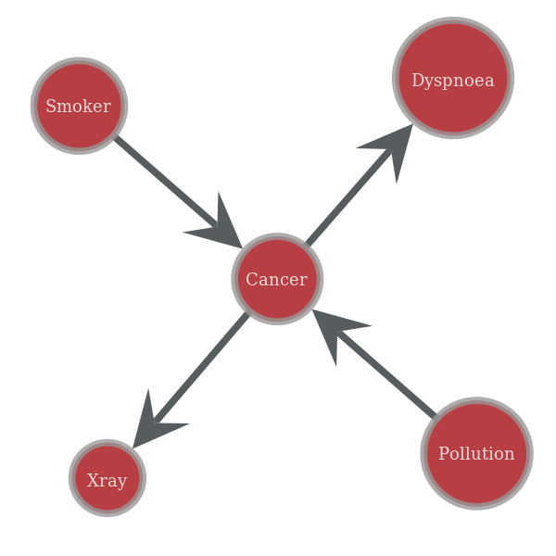
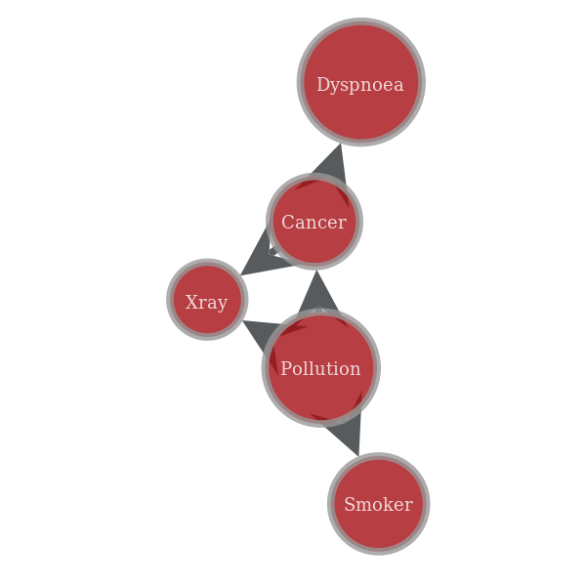
Part II – Sample Solution
True network
Found network

Slide 15
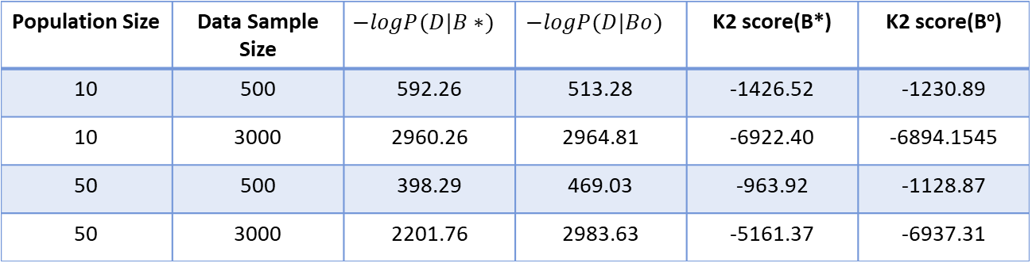
Simulation Result(Asia Network)
Population Size | Data Sample Size | $$−logP(D|B∗)$$ | $$−logP(D|Bo)$$ | K2 score(B*) | K2 score(Bº)
10 | 500 | 592.26 | 513.28 | -1426.52 | -1230.89
10 | 3000 | 2960.26 | 2964.81 | -6922.40 | -6894.1545
50 | 500 | 398.29 | 469.03 | -963.92 | -1128.87
50 | 3000 | 2201.76 | 2983.63 | -5161.37 | -6937.31
No. of generation = 100, pc = 0.5, pm=0.01,

Slide 16
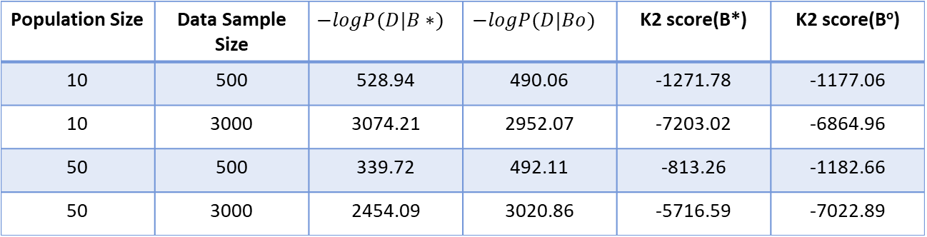
Simulation Result(Asia Network)
Population Size | Data Sample Size | $$−logP(D|B∗)$$ | $$−logP(D|Bo)$$ | K2 score(B*) | K2 score(Bº)
10 | 500 | 528.94 | 490.06 | -1271.78 | -1177.06
10 | 3000 | 3074.21 | 2952.07 | -7203.02 | -6864.96
50 | 500 | 339.72 | 492.11 | -813.26 | -1182.66
50 | 3000 | 2454.09 | 3020.86 | -5716.59 | -7022.89
No. of generation = 100, pc = 0.9, pm=0.01,

Slide 17
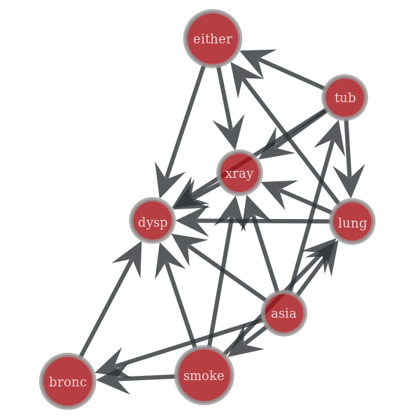
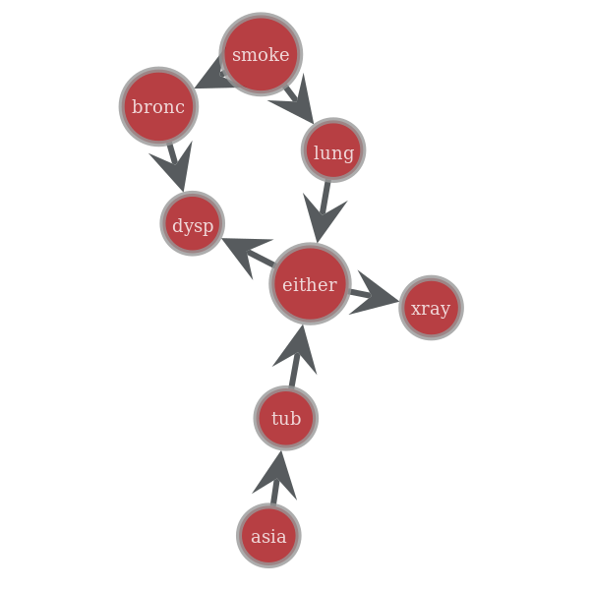
Sample Solution(Asia Network)
True network
Found network

Slide 18
Observation
Increasing the data sample size gives better result
Increasing the no of population doesn’t result in significantly improved change in performance (mainly depends on how fit the samples are to the found structure) but the computation becomes slower.
Increasing the crossover probability gives better result

Slide 19
References
Pedro Larranaga, et al, Structure Learning of Bayesian Networks by Genetic Algorithms: A performance analysis of Control Parameters, IEEE Transactions of pattern Analysis and Machine Intelligence, Vol. 18, No. 9, Sept, 1996
Ben-Gal I., Bayesian Networks, Encyclopedia of Statistics in Quality and Reliability, Wiley & Sons, 2007
https://www.bayesserver.com/docs/introduction/bayesian-networks Retrieved on 18th March, 2018

